Slide 1
THE UNMOTIVATED AND SELF-MOTIVATED CLASSROOMS HOW TO MOTIVATE THE UNMOTIVATED TO LEARN
PRESENTER: CAO Hồng Phát
Ho Chi Minh City University of Education

Slide 2
Introduction
1/ What are the major discrepancies between the unmotivated classroom and the self-motivated classroom?
2/ What are the roles of the teachers in the unmotivated and the self-motivated classroom?
3/ How can a teacher motivate the unmotivated to learn especially ESP students?

Slide 3
Literature review
Motivation
Types of motivation

Slide 4
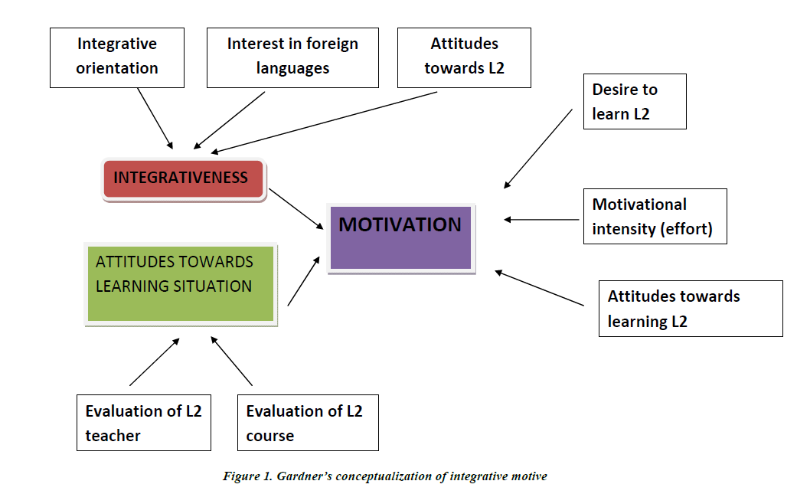
Literature review

Slide 5
The unmotivated classroom
Unmotivated students are the ones who never concentrate on the lessons or what the teacher is talking or very little, use the classroom as a bedroom, i.e. the ones who use the class hour as nap time, sit at the back of the classroom, constantly talk to their friends, learn and prepare other subjects in the classroom, hardly do the homework and exercise, never know what page we are on when they are called on, look tired and bored, and come late.

Slide 6
The self-motivated classroom
The students in the self-motivated one are always eager to learn and raise questions in the classroom. Moreover, these students participate in all the classroom activities conducted by the teachers and this make the classroom become a truly student-centered classroom.

Slide 7
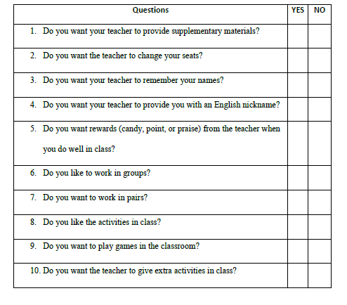
The survey conducted at UOE

Slide 8
How to motivate the unmotivated to learn?
MOTIVATIONAL TEACHING PRACTICE

Slide 9
How to motivate the unmotivated to learn?
Change their seats. Move the students up front. Form a semi-circle. These activities belong to the broad concept of classroom management.
Find out their interests and add them to the lessons.
Reward them for positive behavior using points, stars, candies, or just praise.
Use their names or nicknames. Give them foreign names.
Ask easy questions instead of using long and complicated questions; use Wh questions for better students.
Use student-centered approach; in other words, more student talking time and less teacher talking time.

Slide 10
How to motivate the unmotivated to learn?
Have more pair work and group work rather than teaching everybody together.
Spend more time with them and move to the back of the class.
Learn as much as you can about their personal lives and problems.
Find a special skill that each of them can use and show in the classroom.
Make your classroom a place of rewards, not punishments
Create the classroom that makes the students eager to come; add some fun!
Give them a detailed explanation of the rules of the class as well as the course schedule

Slide 11
How to motivate the unmotivated to learn?
Look at ourselves in the mirror (self-reflection) and ask ourselves these questions
When I was in school, was I equally motivated to learn every subject?
What kind of teacher am I compared to my favorite teacher in school? Why can’t I be more like her/him?
Do my students enjoy studying with me? Am I kind? Am I friendly to everybody? Am I helpful to every students including them? Do I try to understand the problems they have? Do I seem to really care about each of them?
Will they always remember me as their favorite teacher? Why not?
How can I improve myself as a teacher of the unmotivated students?

Slide 12
THANK YOU FOR YOUR ATTENTION

