Slide 1
Using Web Mediated Intercultural Exchanges in EFL Learning
Catherine Peck

Slide 2
Presentation Overview
Intercultural Competence
Context of Projects
ICC & Web 2.0 Technologies
Exchange 1
Exchange 2
Insights, not findings

Slide 3
Intercultural Competence
1. “the ability to communicate effectively and appropriately in intercultural situations based on one’s intercultural knowledge, skills and attitudes”
2. “Ability to shift frame of reference appropriately and adapt behavior to cultural context; adaptability, expandability and flexibility of one’s frame of reference/filter”
3. “Ability to identify behaviors guided by culture and engage in new behaviors in other cultures even when behaviors are unfamiliar given a person’s own socialization”
Deardorff (2006)

Slide 4
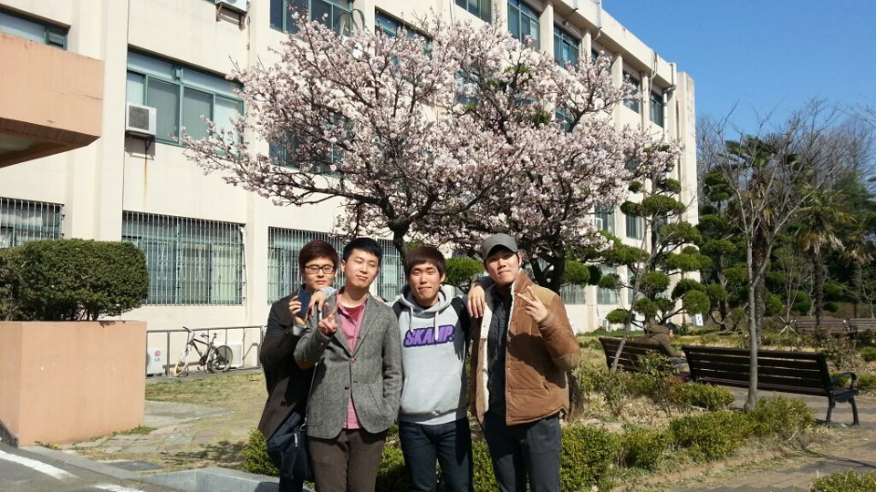
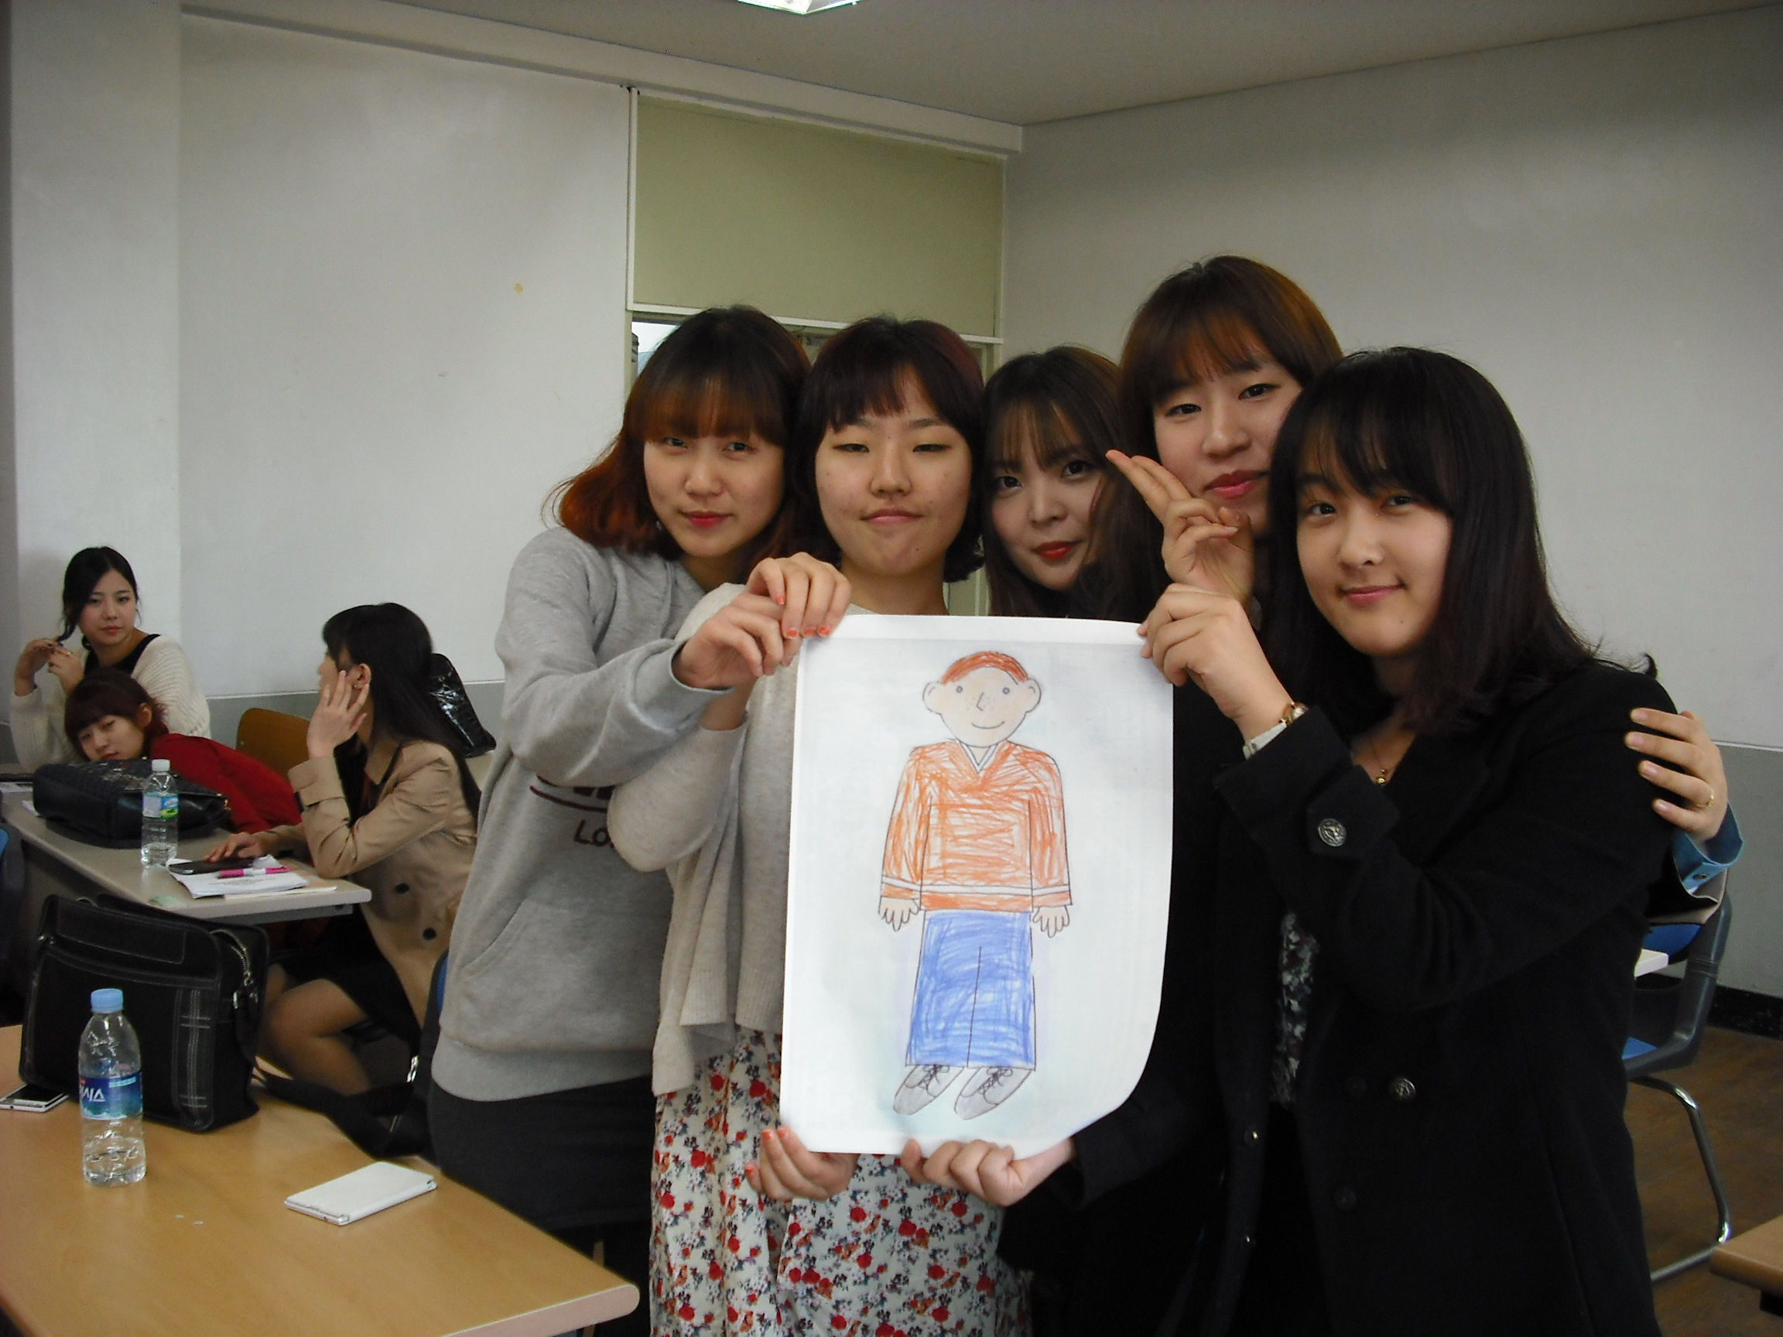
Context of Projects

Slide 5
ICC & Web 2.0 Technologies
Learner Products
Instructional Goals
Task Outcomes

Slide 7
Exchange 1
Macro-context ‘cultnet’ & intercultural citizenship
Student profiles: US / Korea
Tools: Voicethread (collaborative), Google Docs (collaborative), Class Discussion Videos

Slide 12
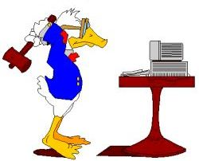
Challenges

Slide 13
Student Feedback
Opportunity
Technology
Partners
Challenge

Slide 14
“I had never participated in a project like this one before. Now this project is a little difficult but interesting! I want to participate project like this in the future of course [sic]” (M12)
“If I had another chance I will participate it, because it is an opportunity to meet other nations and cultures so it is helpful to know more about the world [sic]” (F3)
“I want to do it again because I can learn cultures from real person, not books [sic]” (M7)

Slide 15
Exchange 2
Student requested/reduced lead-in time
‘Convenience’ partners – EFL around the globe
Facebook
Non-assessed, some mandatory posts

Slide 18
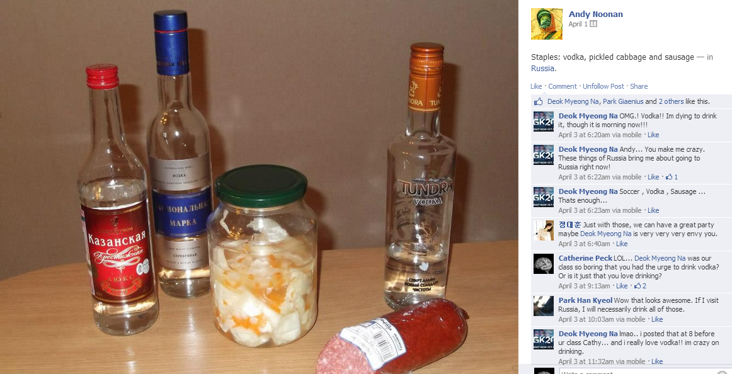

Slide 20
Opportunity
A new/unique & motivating experience
Communicating with ‘foreigners’ a rare opportunity
Partners
Offered opportunities for cultural learning*
Perceived social identity a factor - interaction with ‘peers’ is also desirable
Tasks
Preference for autonomous participation, distinct from formal learning tasks (as per Pritchard, 2013)
Mixed perceptions regarding the project’s value in relationship to language learning
Further exchanges strongly desired
Notes:
&

Slide 21
“It was a new experience for me so it was interesting for me in terms of meeting with foreigner [sic]” (M1)
“It was very fresh experience for me because I rarely have had a chance to communicate with foreigners” (M3)
“I think this project has been very successful by far. Most of us enjoy this Facebook project. In addition, we don’t have sufficient opportunity to communicate with foreigners, but this project gave us that kind of chance” (M7)

Slide 22
Insights, not findings…
Intercultural exchanges using Web 2.0 technologies may offer an entirely new, engaging and motivating experience to EFL learners
University age learners may prefer sustained & in depth interactions, and opportunities to meaningfully develop personal networks
Some congruence in social identity & language ability between exchange partners is desirable
Tools/platforms for exchange should be selected with consideration of how formal, informal or autonomous interactions will be

Slide 23
Thank you! Any Questions?

