Slide 1
Examining the lens that focuses on learners: Teacher ‘habitus’ and its classroom effects
PRESENTER:
Heather Swenddal
M.A. TESOL—San Francisco State University
English Language Educator Professional Learning Liaison
www.rmit.edu.vn

Slide 2
Who are you?
Why are you here?

Slide 3
WHO YOU ARE
affects HOW YOU TEACH

Slide 4
How
Who
are you?
How do you behave in certain situations?
How do you move your body?
What words do you say?
Why?

Slide 5
Habitus:
Each person’s set of embodied dispositions
VALUES
beliefs
that guide her actions and perceptions.
culture
knowledge
Habitus forms her “ways of being in the world”—habits of mind and body.
tastes
experiences
(Bourdieu, 1977 & 1990)

Slide 6
VALUES
Habitus guides perception
beliefs
culture
knowledge
Habitus guides action
tastes
experiences

Slide 7
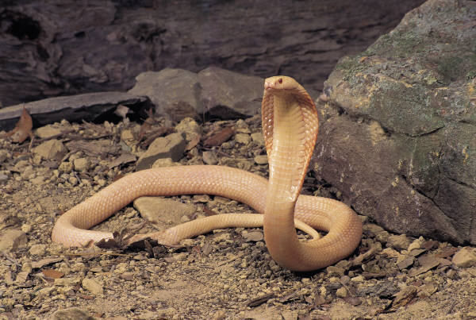

Slide 10
Habitus operates below the level of conscious thinking.
It is the “embodied history” of our experiences, “internalized as second nature,” and then forgotten.
(Bourdieu, 1990, p. 56)

Slide 11
awareness of habitus functions can occur at any point in this process…
… but often it does not.
VALUES
Habitus guides perception
beliefs
culture
knowledge
Habitus guides action
tastes
experiences

Slide 12
Habitus is a “feel for the game”
(Bourdieu, 1998;
Wacquant, 2004a)
Habitus underlies practitioner behavior in all practices, including teaching.
(Roth, et al., 2000)

Slide 13
Micro-analytical study:
Ways an ESOL teacher uses her body to balance two needs: managing time while communicating care
Kathryn
ESOL teacher
Gabrielle
ESL student

Slide 14
In all instances of learner storytelling studied, Kathryn positions herself as an active listener by…
Shifting her gaze to Gabrielle
Nodding at key moments
Facing Gabrielle with her whole body—no torque

Slide 15
In all instances of learner storytelling studied, Kathryn returns to the main teaching activity by…
Responding to Gabrielle’s story and relating it to larger activity
Shifting gaze to the chalkboard
Gently torquing her body toward the chalkboard

Slide 16
Kathryn was not consciously aware of the bodily movements that helped her balance these needs
Beliefs about teaching
her habitus guided her actions
knowledge of essay’s needs
past experiences with Gabrielle—time mgmt
genuine concern for Gabrielle
20+ years of teaching exp

Slide 17
What does your habitus look like?
What are your embodied dispositions, and how do they impact your teaching?
VALUES
beliefs
culture
knowledge
tastes
experiences

Slide 18
Two methods of exposing your habitus:
STUDY ITS EFFECTS:
Videotape yourself teaching. Watch and notice things you do. Ask yourself “why did I do that?”
Practice mindful teaching: notice your behavior and think about its source.
VALUES
beliefs
culture
knowledge
tastes
experiences

Slide 19
Two methods of exposing your habitus:
STUDY ITS COMPONENTS:
Write a teaching philosophy and think about your values, beliefs, knowledge, etc.
Ask and answer questions about your teaching values, beliefs, knowledge, etc.
VALUES
beliefs
culture
knowledge
tastes
experiences

Slide 20
How to improve your teaching habitus
Expose aspects of your current habitus. Try to understand why you do what you do.
Scrutinize your values, beliefs and attitudes. Eliminate unproductive/inappropriate thoughts.
Cultivate a genuine respect and care for students, and spend time with like-minded people.
Observe good teachers whenever you can.

Slide 21
Tips for trainers/institutional leaders
Habitus is enculturated—“group habitus” influences individual habitus. Promote values and orientations that you want teachers to internalize.
Provide opportunities for co-teaching. “Being together with another” can aid habitus transformation (Roth, et al., 2000).
Provide opportunities for peer observation, which can expose habitus elements for the observed and provide implicit training for the observer.

Slide 22
Thank you for coming!
Questions?

