Slide 1


Buriram Rajabhat University, Thailand
Vocabulary Development: A Case Study of teaching English Idioms
by Comparing with Thai Idioms
Asst. Prof. Dr. Akkarapon Nuemaihom
Affiliation: Buriram Rajabhat University
Tel: 081-8204402
e-mail: akkarapon2512@yahoo.com

Slide 2
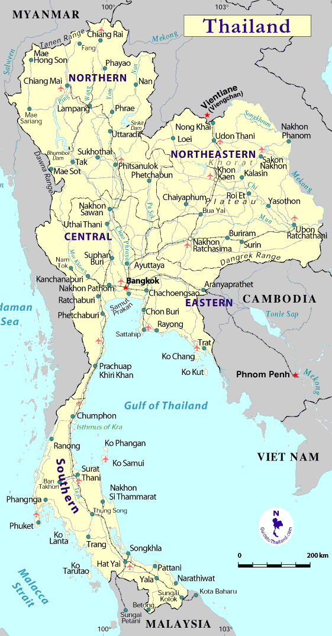
Buriram Rajabhat University, Thailand

Slide 3


Well-known Tourist Attractions

Slide 4



Buriram Rajabhat University, Thailand

Slide 5
Buriram Rajabhat University, Thailand
The presentation will be divided into 5 Parts as follows:
1. Study Significance
2. Study Objectives
3. Study Methodology
4. Study Results
5. Conclusion
And Q & A

Slide 6
Buriram Rajabhat University, Thailand
Study Significance
Knowledge of vocabulary or word meaning in a given passage is a key to reading comprehension.
Baker, Simmons, and Kame'enui (1988) state that the relation between reading comprehension and vocabulary knowledge is strong and unequivocal.
For English language learners (ELLs), vocabulary development is inevitably significant.

Slide 7
Buriram Rajabhat University, Thailand
Teachers can teach vocabulary directly or indirectly.
A variety of effective methods of teaching vocabulary can be used in order to increase a student's ability to learn new words, such as…
* Using gestures
* Pictures, and
* Comparing an English word with a native language etc.

Slide 8
Regarding English idiom acquisition, a lot of teaching activities were proposed to help students use English idioms effectively, such as….
Teaching idioms in context
Teaching idioms with illustration, and
Comparing English idioms with local languages etc.

Slide 9
Buriram Rajabhat University, Thailand
All these instructional activities were employed because English idioms with literal meanings are not only difficult for EFL learners but also for English native speakers.

Slide 10
Buchwald (2000) states that the trouble with foreigners in this country is that they take everything Americans say literally.
If EFL learners are able to master English idioms, they can understand American culture.
Ex: A piece of cake (Physics is a piece of cake)
Cake is available everywhere in America, like rice is eaten everywhere in Thailand.
Cooper (1999) says that idioms are common in American daily life and provide a rich source of American culture.

Slide 11
Buriram Rajabhat University, Thailand
Thai students who learn English as a foreign language (EFL) also have problems of understanding and memorization of English idioms.
The researcher is, therefore, interested in doing a research entitled “Vocabulary Development: A Case Study of teaching English Idioms by Comparing with Thai Idioms” in order to find an effective and practical method of teaching English idioms.

Slide 12
Buriram Rajabhat University, Thailand
Study Objectives
The study aims to develop Thai students’ English idioms by comparing with Thai idioms, using various effective activities.

Slide 13
Buriram Rajabhat University, Thailand
Study Methodology
The samples: 42 students in the English Program, Buriram Rajabhat University, Thailand.
The second year students taking the course Socio-Cultural Background of English Speaking Countries in the first semester of the academic year 2013.
The lesson entitled “English Idioms” of this course was taken as a case study.

Slide 14
Buriram Rajabhat University, Thailand
The pre-test and post-test were also given to check their improvement of learning English idioms.
This study is partly based on the activities of teaching English idioms proposed by Su-Yueh Wu (2008) who used various effective activities for teaching English idioms to college EFL students
……….. teaching English idioms in context, with rich illustration, with group discussion, with readers theater, with retelling and rewriting, and with dialogue writing and role-play.

Slide 15
Buriram Rajabhat University, Thailand
Some parts are adapted from “How to Teach English Idioms and Their Meaning” online written by Claudia Pesce (2010) who suggested six steps of teaching English idioms…….
Choose five to eight idioms that may be easily grouped
Introduce idioms in context and never in isolation
Students create conversations using idioms
etc.

Slide 16
Buriram Rajabhat University, Thailand
Study Results
The findings revealed that the effective and practical activities used to teach English idioms by comparing with Thai idioms were as follows:
1. Classifying English and Thai idioms into groups and comparing them word by word

Slide 17
Buriram Rajabhat University, Thailand
Most English and Thai idioms fall into simple categories, like idioms with animals, parts of the body, and tools etc.
Seven groups of Thai idioms were found in this study i.e.
Society, Ways of life and Livelihood,
2) Religion, Morality, Ethics, Goodness and Badness,

Slide 18

Buriram Rajabhat University, Thailand
3) Manners and Behavior,
4) Family and Relatives,
5) Man’s Parts of Body,
6) Articles, Tools and Instruments and
7) Animals, and their Behavior and Nature.
Look at the examples in the table:

Slide 19
Buriram Rajabhat University, Thailand
Groups of Idioms | Thai Idioms | English Idioms
1. Society, Ways of Life and Livelihood | Dek Muae Wan Suen (A child who was born the day before yesterday) | Born yesterday
2. Religion, Morality, Ethics, Goodness and Badness | Fang Rok Rak (bury a placenta) | Put down roots
3. Manners and Behavior | Nam Sai Chai Ching (pure water, sincerity) | From the bottom of one’s heart

Slide 20
Buriram Rajabhat University, Thailand
Groups of Idioms | Thai Idioms | English Idioms
4. Family and Relatives | Luk Mai Lon Mai Klai Ton (Fruits fall to earth near the tree) | A chip off the old block
5. Men’s Parts of Body | Lang Mue | Wash one’s hand of
6. Articles, Tools and Instruments | Ngiap Pen Pao Sak (quiet as a pestle) | Quiet as the grave
7. Animals, and their Behavior and Nature | Luen Muean Pla Lai | Slippery as an eel

Slide 21
Buriram Rajabhat University, Thailand
2. Use English and Thai idioms in contexts
Students were taught how to use English idioms by providing them with examples in context because learning English idioms in meaningful context is better than learning isolated words through memorization.
Nippold & Martin (1989) also state that linguistic contextual information enhances adolescents’ interpretation of idioms.

Slide 22
Buriram Rajabhat University, Thailand
Some idioms were taken from the aforementioned table to form English sentences.
Moreover, the translation from English into Thai might be needed to make students understand better.
But prior to translation, they were asked to guess the meanings first, then tell the teacher in Thai.
Look at the examples:

Slide 23
Buriram Rajabhat University, Thailand
English is a piece of cake because everybody can learn it.
After the tsunami, the town was as quiet as the grave.
I would like to warn you to not do business with that guy because he is as slippery as an eel.

Slide 24
Buriram Rajabhat University, Thailand
3. Retelling and rewriting English idioms
First, the students were introduced to the meaning of a particular English idiom
Second, they were asked to retell the content in Thai language.
Finally, they rewrite sentence provided by using English idioms.
By doing this, they will have a chance to practically use and get familiar with English idioms that they have just learned.

Slide 25
Buriram Rajabhat University, Thailand
For instance, the meaning of the Thai idiom “Sang Wi Man Nai Akat” for the English idiom “Build castles in the air” was given.
Then they were asked to rewrite the sentence provided.
They might write a sentence in Thai, and the teacher translated it into English and let them read the full sentence out loud.
Ex: Suchart likes to build castles in the air; he imagines that he will win the lottery and becomes a rich man.

Slide 26
Buriram Rajabhat University, Thailand
4. Using English idioms through conversations
The students were divided into pairs and each pair got one English idiom to form their conversation.
They were asked to present their speech with at least one English idiom in front of the class.
Prior to their presentation, an example of conversation with Thai and English idioms was given.
Look at the example:

Slide 27
Buriram Rajabhat University, Thailand
Kaew: Hi Jom, you look sad today. What’s wrong with you?
Jom: Well, I didn’t do very well on my English exam. If I failed, I will definitely Khai Na (lose face).
Kaew: Take it easy. Everything will be ok.
Would you like to try to make a conversation by using this idiom?:
“Give somebody the green light”

Slide 28
Buriram Rajabhat University, Thailand
5. Teaching English idioms with pictures
Pictures / illustrations / cartoons help students understand English idioms better and memorize them longer.
The teacher presented a particular English idiom with a picture or a cartoon, then the students were asked to guess the meaning of an English idiom by looking at a picture.
They might answer in Thai.

Slide 29

Can you guest Eng. idiom from this cartoon?

Slide 30
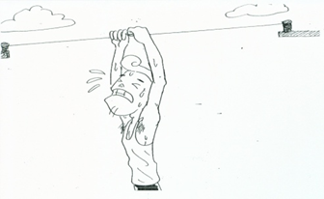
What about this?

Slide 31
Buriram Rajabhat University, Thailand
Khi Kiat San Lang Yao (bone idle)
Example:
He is truly bone idle. He wastes his time by doing nothing but watching TV and playing games.

Slide 32
Buriram Rajabhat University, Thailand
Khwaen Yu Bon Sen Dai (Hang by a thread / hair)
Example:
After the risky operation, her life hung by a thread for several hours.

Slide 33
Buriram Rajabhat University, Thailand
6. Using a matching game and gap-filling exercise
Word matching and gap-filling are also very effective for teaching English idioms.
By doing these activities, Thai idioms were presented together with English idioms in order to check students’ understanding and help them to develop and use English idioms successfully.
The correct answers to questions would be given to students at the end of the class.

Slide 34
Buriram Rajabhat University, Thailand
Instruction: Match Thai idioms on the left with English idioms on the right.

Slide 35
Buriram Rajabhat University, Thailand
Instruction: Fill in the missing idiom in each of the following sentences using the English idioms given in the first exercise:
Why do you complain about being fired? You ……when you called your boss crook.
A job’s not going to just……. You’ll have to go out and find one by yourself.
When the factories closed at the time of economic crisis and hundreds of people lost their jobs, all storekeepers were also…..

Slide 36
Buriram Rajabhat University, Thailand
4. The plane trip to Vietnam was long and tiring, but I managed to …. by reading several books.
5. It makes me very angry when I see Somsak ……our boss’s ….all the time for the purpose of getting a promotion.
6. Some poor and uneducated people are easily…..by some corrupt politicians.

Slide 37
Answer Keys
Ask for trouble
2. Drop into your lap
3. In the same boat
4. Kill time
5. Lick….boots
6. Led by nose

Slide 38
Buriram Rajabhat University, Thailand
Conclusion
It is concluded that:
The activities proposed and designed by the researcher were vital for students to learn and master English idioms because….
These collaborative activities allow them to compare, to think and to interact with their friends in learning English idioms in four skills.

Slide 39

Buriram Rajabhat University, Thailand
Their capability of using English idioms was higher than before teaching via the activities.
Their average post-test scores were also significantly higher than their pre-test scores.
Having interviewed individual students, it also revealed that they were satisfied with the instructional activities and able to desirably develop their English idioms.

Slide 40
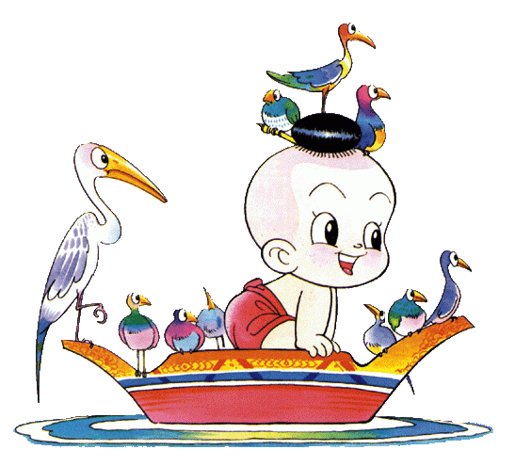
THANK YOU
FOR YOUR GREAT ATTENTION!!
Buriram Rajabhat University, Thailand

