Slide 1
Virtual I- Program in the Language Classrooms: Possibilities and Potentials
FARINA NOZAKIAH TAZIJAN
SUZANA AB. RAHIM
UiTM MALAYSIA

Slide 2
INTRODUCTION
Poor emphasis on formal presentations in university is lagging far behind from preparing the graduates for real workplace oral communication.
It is almost impossible for students to practice their presentation skills in front of their classmates and lecturers due to time constraint and the growing numbers of students in a classroom

Slide 3
What is ViP?
Virtual-i Presenter (ViP) allows students to create, review and evaluate oral presentations using a webcam and a power point presentation
The ViP program integrates :
- a power point presentation with a digital video
-recording of the presenter (captured by a webcam)
-recreates how a student would deliver an oral presentation in class.

Slide 4
OBJECTIVE
This research is hoped to provide an insight on how these undergraduates’ presentation skills can be honed via the use of new technologies brought about in the language learning process.

Slide 5
PILOT STUDY
1st
Stage
Students were asked to download the trial version of the ViP that was made available on the internet.
2cnd
Stage
At the end of the 10th week of the semester, students were then allowed to use the ViP program on their own to practice and submit their presentations via the ViP software.
As most students do have laptops that are equipped with webcams and microphones, therefore, the application of using ViP was made easy.
3rd
Stage
The data has been collected by the researcher through questionnaires posted via face book where it was being customized to students of the HM220/HM225 class.
Students were given a briefing on how to use the application in class.

Slide 6
ViP Application:A sample of ViP recording :

Slide 7
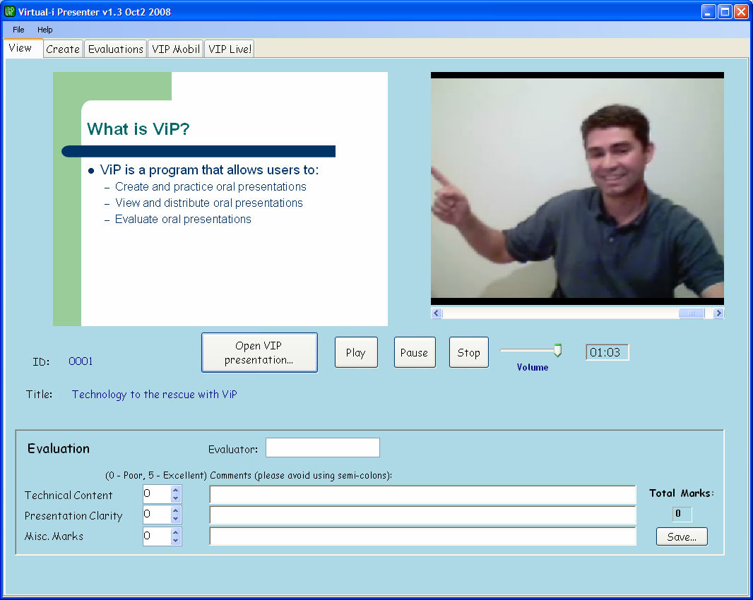
ViP Application
Figure 2: Screen for viewing and evaluating a previously created ViP presentation.

Slide 8
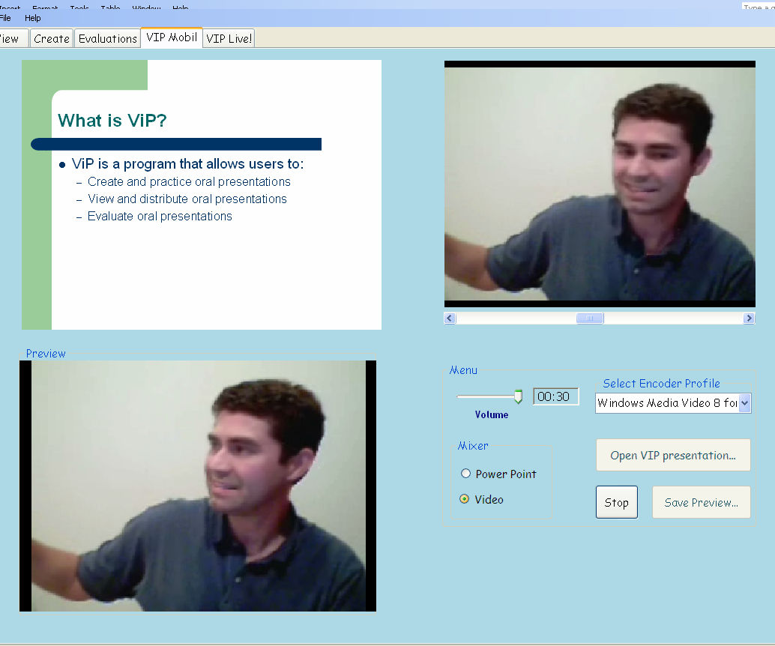
Figure 3. Creating a mobile device video from a ViP presentation.

Slide 9
RESULTS & FINDINGS
1. Delivery and Confidence
Overall result indicated that students agree that by using V-IP , this has helped them to make a better delivery in terms of speech rate and managing sequences of their oral presentation skills.
Due to the nature of this program, it allows students to practise as many times as they opt for.

Slide 10
RESULTS & FINDINGS
2. Language
Majority of the students agreed that fluency, apart from intonation and pronunciation have been paid more attention to with the presence and usage of the software.

Slide 11
RESULTS & FINDINGS
3. Content and organization
Half of the respondents also strongly agreed that they were able to come up with a better effort at providing a review and a conclusion to cap their presentations.
In fact, they also agreed that with the repeated efforts in using the software, they have also come up with a better introduction and preview of the main points they are to present.

Slide 12
RESULTS & FINDINGS
4. Non verbal communication
Due to their usage of this program, they are also able to communicate their ideas better by portraying certain non verbal communication cues such as varying their voice pitch and projecting their voice well and not monotonous

Slide 13
RESULTS & FINDINGS
5. Evaluation of the system
Most of the students find the VIP software to be helpful and assisting.
The program enabled the students to practise, organize and review presentations so as to improve and enhance their presentation.
This software also helped the students to be aware of the importance of presentation skills; the ability to preview the mark scheme and evaluation weight age has actually made it more interesting for them to be utilizing this software as compared to the ordinary classroom presentation

Slide 14
LIMITATIONS
Absence of live audience, eye contact, gestures
Recapturing the video when making errors
- not being able to edit or pause
3. Technical difficulties
-setting up the program
Language

Slide 15
CONCLUSION
In large class, assigning lecture time class for oral presentation becomes unfeasible, ViP allow students to practice and perfect their presentation.
However, there is still room for students’ improvement via the use of V-I-P. Students tend to appreciate presentations that are uniquely delivered rather than focusing on the content.

Slide 16
Peer review would certainly help to foster skills of professional judgement.
Provides ample opportunities for students to explore their own potentials in enhancing their ability to communicate effectively via the use of this software.
Both the visual powerpoint and the oral presentations applicable in this software will allow the students to witness their own presentations and be as part of the audience.

Slide 17
Thus, by being a part of a more authentic environment, students will be able to use any feedback obtained to further improve their individual oral presentation skills.

