Slide 1
The Research-Teaching Nexus in the Context of Reaching Research University Status Ahmad Zamri Mansor, Fazilah Idris, Rozita Ibrahim, Mashitoh Yaacob, Zaharah Hassan, Latifah Amin & Anwar Maso’od
Centre for General Studies Universiti Kebangsaan Malaysia

Slide 2
PRESENTATION OUTLINE
1. Introduction
2. What is Research University?
3. Research University in Malaysia
4. The Case of UKM
5. Concluding Remarks

Slide 3
1. Introduction
mission of ‘research university’ status --to transform universities towards research orientation, → promoting the findings of new knowledge → contribute to the creation of the country’s wealth.
‘research university’ --the role of creating new knowledge is highlighted more than the transmission of knowledge→→ against the commonly held perception by academicians that teaching and research should complement each other.
Thus, the drive towards the ‘research university’ status has profound implications on academicians’ perspective on research and teaching.

Slide 4
2. What is Research University?
Characteristics of high quality research universities:
(1) high quality faculty committed to research and teaching,
(2) high quality graduate students who want to learn to perform research or function with advanced expertise,
(3) an intellectual climate that encourages scholarship,
(4) facilities in which teaching and research can be performed effectively,
(5) funding for operations and instructions,
(6) research funding,
(7) research infrastructure, and finally (8) high quality leadership.
Bienenstock (2006:2)

Slide 5
3. Research University in Malaysia
In 2006, four public universities were categorised as research universities:
Universiti of Malaya (UM),
Universiti Sains Malaysia (USM),
Universiti Kebangsaan Malaysia (UKM), and
Universiti Putra Malaysia (UPM).
catalyst for the nation economic growth→enhancing the quality of the citizens.

Slide 6
8 Criteria Of The Selection Of A Research University
(a) the quantity and quality of researchers,
(b) the quantity and quality of research,
(c) the quantity of postgraduate,
(d) the quality of postgraduate,
(e) innovation,
(f) professional service and reward system,
(g) networking and collaboration, and
(h) support service.

Slide 7
Partnership with the government
incentives given by the Ministry of Higher Education (MOHE) through the allocation of research grants :
Explorative Research Grant Scheme (ERGS),
Fundamental Research Grant Scheme (FRGS),
Long-term Research Grant Scheme (LRGS), and
Prototype Research Grant Scheme (PRGS).

Slide 8
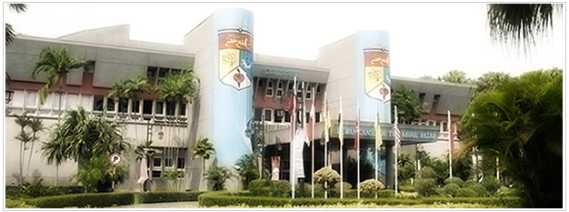
National University of Malaysia (UKM)

Slide 9
Motto Inspiring futures, nurturing possibilities. Vision UKM is committed to be a leading university that pioneers innovation in the construction of knowledge to achieve the aspiration of producing a society imbued with dynamic, learned and civic leadership. Mission UKM is the National University that safeguards the sovereignty of the Malay language while globalizing knowledge in the context of local culture.

Slide 10
Philosophy A combination of faith in Allah and beneficial knowledge and of theory and practice as the basis for the advancement of knowledge, the education of society and the development of the University. Aims To become a leading and competitive centre of knowledge, enriched with technology that: • Affirms and promotes the value of Malay as a language of learning; • Builds a dynamic and ethical society; • Internationalizes UKM's image and contribution to the global community; • Stimulates the development of technologies beneficial to society.

Slide 11
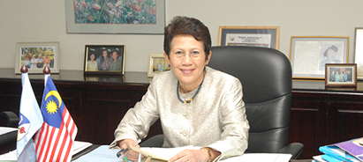
Vice Chancellor
YBHG. PROF TAN SRI DATO' WIRA DR. SHARIFAH HAPSAH SYED HASAN SHAHABUDIN
ACADEMIC QUALIFICATIONS
Bachelor of Medicine; Bachelor of Surgery M.B.B.S. (Mal), 1973
Master of Health Personnel Education M.H.P.Ed (NSW), 1982
Doctorate in Medicine M.D. (Mal), 1997
Fellow of the Academy of Medicine FAMM, 1999
Fellow of the Academy of Science FASc, 2006
FIELD OF SPECIALIZATION
Medicine, Medical Education, Distance and Continuing Education, Higher Education Policy and Management, Quality Assurance and Accreditation.

Slide 12
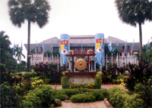
Introduction
National University of Malaysia (UKM)
Situated in Bangi, Selangor and is one of Malaysia’s public.
Has another branch in Kuala Lumpur and a teaching facility in Cheras.
UKM is considered as part of the four research universities in Malaysia.
In 2006, it ranked as 185 of the World’s Top 200 Universities.

Slide 13
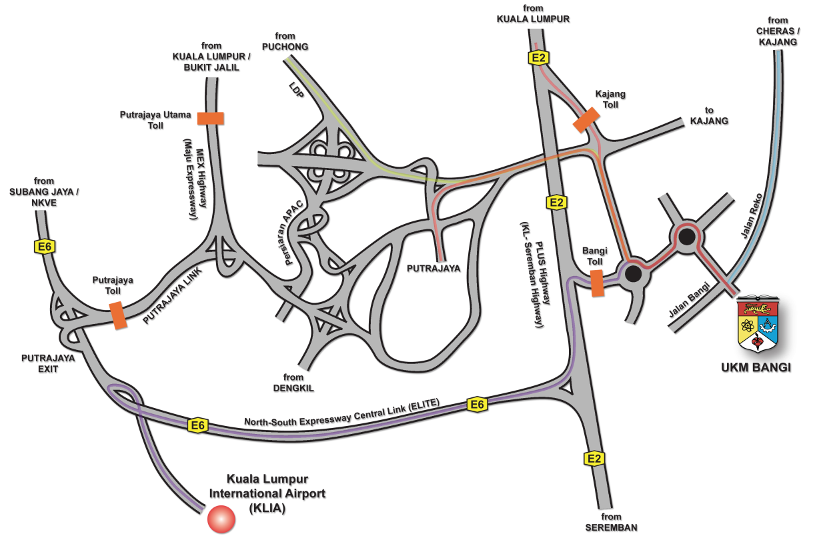
History
The school was established in May 18, 1970.
At first, UKM held its operation at Lembah Pantai, Kuala Lumpur.
This served as a temporary location for the first batch of 192 students as well as the first 3 faculties.
It was in October 1977, that the university moved its quarters to Bangi.

Slide 14
Population
UKM encompasses an academic community of 1,798 (181 professors; 326 associate professors; 1051 lecturers and 174 tutors and 66 teachers), supporting staff of more than 7500 and a student population of approximately 26,844.
Currently, UKM has about 19,371 undergraduate students, and 7,473 postgraduate students of which 1018 are foreign students from 35 different countries.
Since its establishment in 1970 up till 2002, the University has produced more than 104,057 graduates; 93,210 Bachelors, 10,115 Masters and 732 PhDs.

Slide 15
Faculties & Research Institutions

Slide 16
Facilities
Student Development Centre - Responsible for planning and implementing programmes to enable students to achieve academic excellence as well as all around personal development.
Libraries -The Tun Seri Lanang Library serves as the central library
-The Malay World and Civilization Library.
-The Law Library, The Medical Faculty Library and The Tan Sri Lim Goh Tong Virtual Medical Library.
Sports and Recreation -The Danau Golf Club has an 18-hole international standard golf course.
- Clubhouse; gymnasium, seminar rooms, snooker tables, karaoke, TV room, a Pro Shop and a restaurant.
- An Olympic size swimming pool and two wading pools for Golf Club.
-Facilities for football, sepak takraw, basketball, running track, badminton, running track, badminton, tennis and indoor sports are readily available.

Slide 17
Facilities (Cont.)
Security - The University maintains round the clock security patrol and surveillance on campus.
- Security posts are located at the halls of residence and
International Students - The International Affairs in the Centre for Graduate Studies undertakes the task of managing the affairs of the foreign graduate degree students.
- The Centre together with the respective faculties also handles academic activities of the students.
- The welfare of the international student is administrated by the Student Affairs Department housed in the centrally located PUSANIKA.
Centre for Public and International Relations - Advises on event management, media relationship, corporate publication, educational promotion as well as all international affairs encompassing student exchange programme, visits and international communications.

Slide 18
Facilities (Cont.)
Student Health Services - The University provides comprehensive health and dental care to all students for nominal fee.
- The students can also opt for treatment and medication from any government hospitals and more than 30 private clinics which have been listed as UKM panels.
Counseling Service - Trained counselors are available to students giving professionals and confidential advice to students to help them navigate the many trials and tribulations of academic life, and in resolving cross cultural differences.
Accommodation - The main campus in Bangi has 11 colleges and an apartment which can house about 11,000 students.
- The Kuala Lumpur Branch Campus (KKL) has one college that can accommodate approximately 1,700 students.
- The campus in Cheras has one college that can house about 600 students.

Slide 19
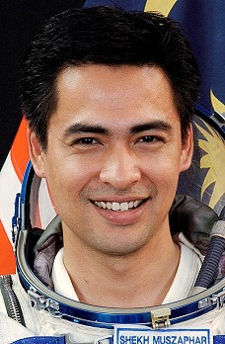
Alumni
The university is home to famous alumni.
One of these is the prominent first astronaut of Malaysia, Sheikh Muzaphar Shukor.

Slide 20
4. The Case of UKM
UKM - research, service and teaching where the research part is emphasized more than the other two parts, i.e., 50% compared to only 30% teaching and 20% service (The Report: Malaysia 2010, 2011).
Rohaty (2008:230) observed that ‘UKM has been vigorously developing monitoring measures to sustain the research intensive university status’.

Slide 21
Eight monitoring measures developed by UKM are:
(a) an average publication of two journals per year per lecturer,
(b) an average research grant of RM50,000 per year per lecturer,
(c) 10 posts of post doctoral appointed per year,
(d) 60% of its academicians are Ph.D. holders, i.e., 5,000 Ph.D. holders by 2015 to contribute to the government’s MyBrain15 programme which aimed at producing 60,000 Ph.Ds by 2020,
(e) ratio of its undergraduate to its postgraduate students is 40:60 percent by 2015,

Slide 22
(f) increment in the percentage of its international postgraduate students, i.e., 15,000 registered postgraduates by 2015,
(g) changes in management to enhance the research university, and
(h) enhancement in university-industry partnership.
and (i) enhancement in university-industry partnership.

Slide 23
5. Concluding Remarks
The drive towards research university status poses some challenges to both university administration and academicians.
This effort towards balancing the functions of research and teaching might be challenging but it has to be undertaken with great care so that the true spirit of a university as an institution that generates new knowledge works in tandem with its role in dissemination of knowledge for the good of the society.

Slide 24
Acknowledgement:
We would like to thank UKM for the research grant UKM-GPP-PPKK-7-2010.

